Slide 1
CONSTRUCTION ADMINISTRATION
REVIT University
AFTER THE PERMIT….
Revit UNIVERSITY – XXX, 2023 PRESENTED BY Andres Fernandez, XX

Slide 2
CONSTRUCTION ADMINISTRATION
VOCABULARY:
RFI: REQUEST FOR INFORMATION
ASK, SK: ARCHITECTURAL SKETCH
ASI: ARCHITECTS SUPLEMENTAL INFORMATION
DELTA Δ: NOTED UPDATES IN CONSTRUCTION DOCUMENTS RELATED TO A SPECIFIC ITEM AND DATE.
FIELD REPORTS: SNAPSHOT IN TIME OF PROJECT PROGRESS
SUBMITTALS: DOCUMENTS PROVIDED BY THE CONTRACTOR TO ORB FOR AN APPROVAL OF USE
SUBTITUTION REQUEST: CHANGES IN PRODUCTS, MATERIALS, EQUIPMENT, AND METHODS OF CONSTRUCTION REQUIRED BY CONTRACT DOCUMENTS PROPOSED BY CONTRACTOR
CYA: COVER YOUR ASSETS

Slide 3
CONSTRUCTION ADMINISTRATION
CONTRACTOR
RFI
INFORMATION IN THE DRAWINGS
OFFICIAL RESPONSE

Slide 4
CONSTRUCTION ADMINISTRATION
CONTRACTOR
RFI
INFORMATION NOT IN THE DRAWINGS
ISSUE ASK, ASI, DELTA
CA COORDINATOR
CA FOLDER
LOGGED UPLOADED ARCHIVED
INFORMATION IN THE DRAWINGS
OFFICIAL RESPONSE

Slide 5
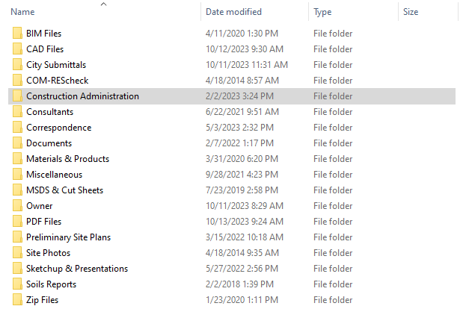
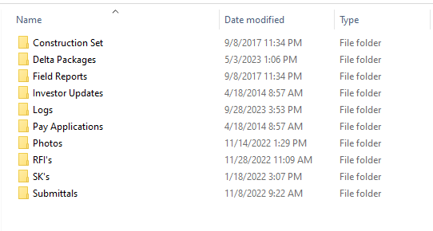
CONSTRUCTION ADMINISTRATION

Slide 6
CONSTRUCTION ADMINISTRATION
CONSTRUCTION SET:
THE LATEST VERSION OF THE CONSTRUCTION DOCUMENTS USED BY THE CONTRACTOR TO FINISH THE PROJECT.
DELTA PACKAGES
ALL SHEETS PERTAINING TO CHANGES IN THE CONSTRUCTION DOCUMENTS DURING A SET PERIOD AND SCOPE
FIELD REPORTS:
DOCUMENTATION BY ORB OF FIELD CONDITIONS – A SNAPSHOT IN TIME OF PROJECT PROGRESS

Slide 7
CONSTRUCTION ADMINISTRATION
RFI’s:
REQUEST FOR INFORMATION - WHEN INFORMATION IS NOT READILY AVAILABLE OR CONTRADICTORY
SK’s: (ASK)
ARCHITECTURAL SKETCH INTENDED TO CLARIFY, CORRECT OR SOLVE FIELD ISSUES NOT STATED IN THE CONSTRUCTION DOCUMENTS
SUBMITTALS:
DOCUMENTS PROVIDED BY THE CONTRACTOR TO ORB FOR AN APPROVAL OF USE

Slide 8
CONSTRUCTION ADMINISTRATION
RFI PROCESS AT ORB
SK’s: (ASK)
ARCHITECTURAL SKETCH INTENDED TO CLARIFY, CORRECT OR SOLVE FIELD ISSUES NOT STATED IN THE CONSTRUCTION DOCUMENTS
SUBMITTALS:
DOCUMENTS PROVIDED BY THE CONTRACTOR TO ORB FOR AN APPROVAL OF USE

Slide 9
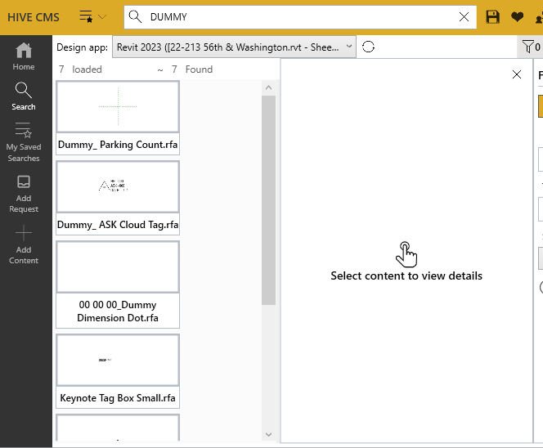

Slide 10
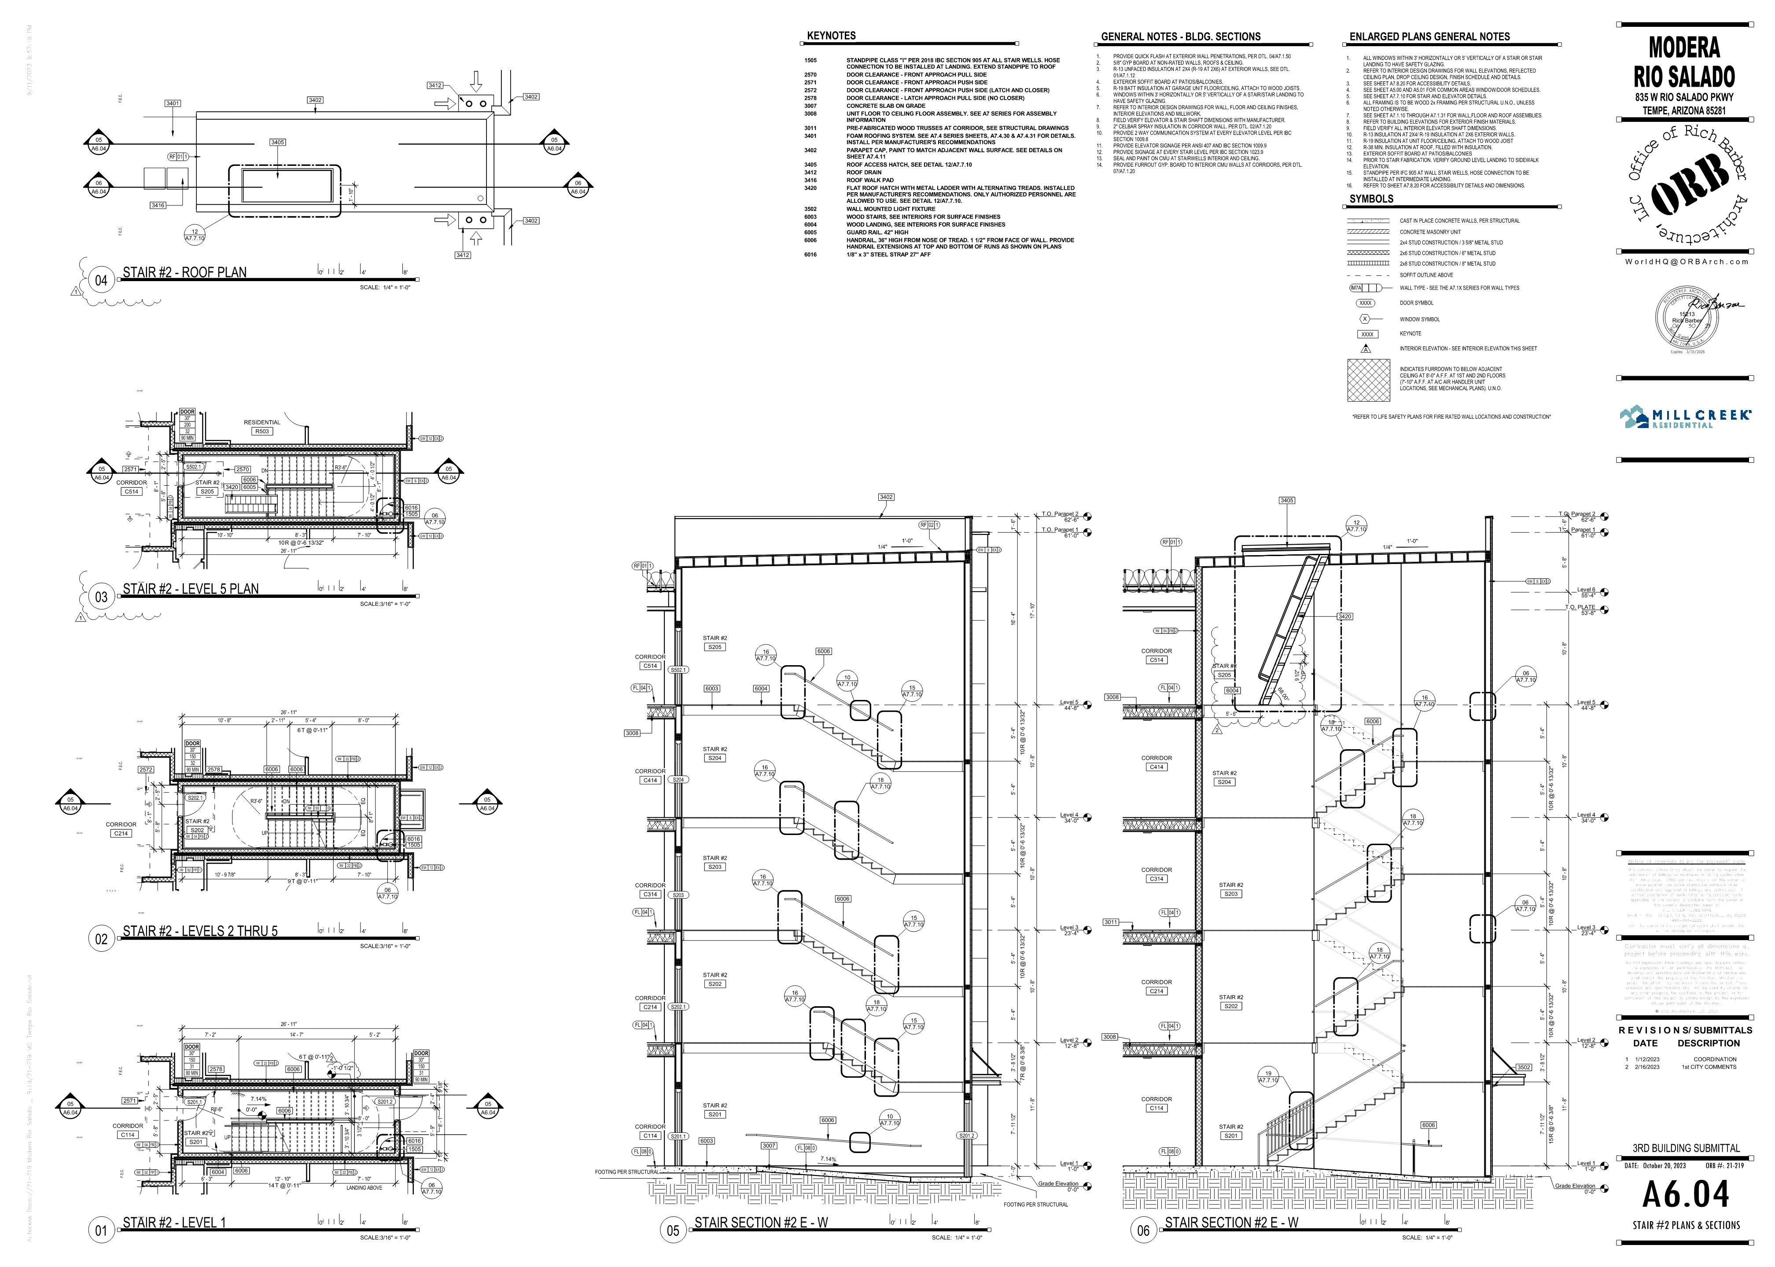
REVISED ELEMENT
SHEET
30X42
DUMMY TAG FOR RFI / ASK

Slide 11
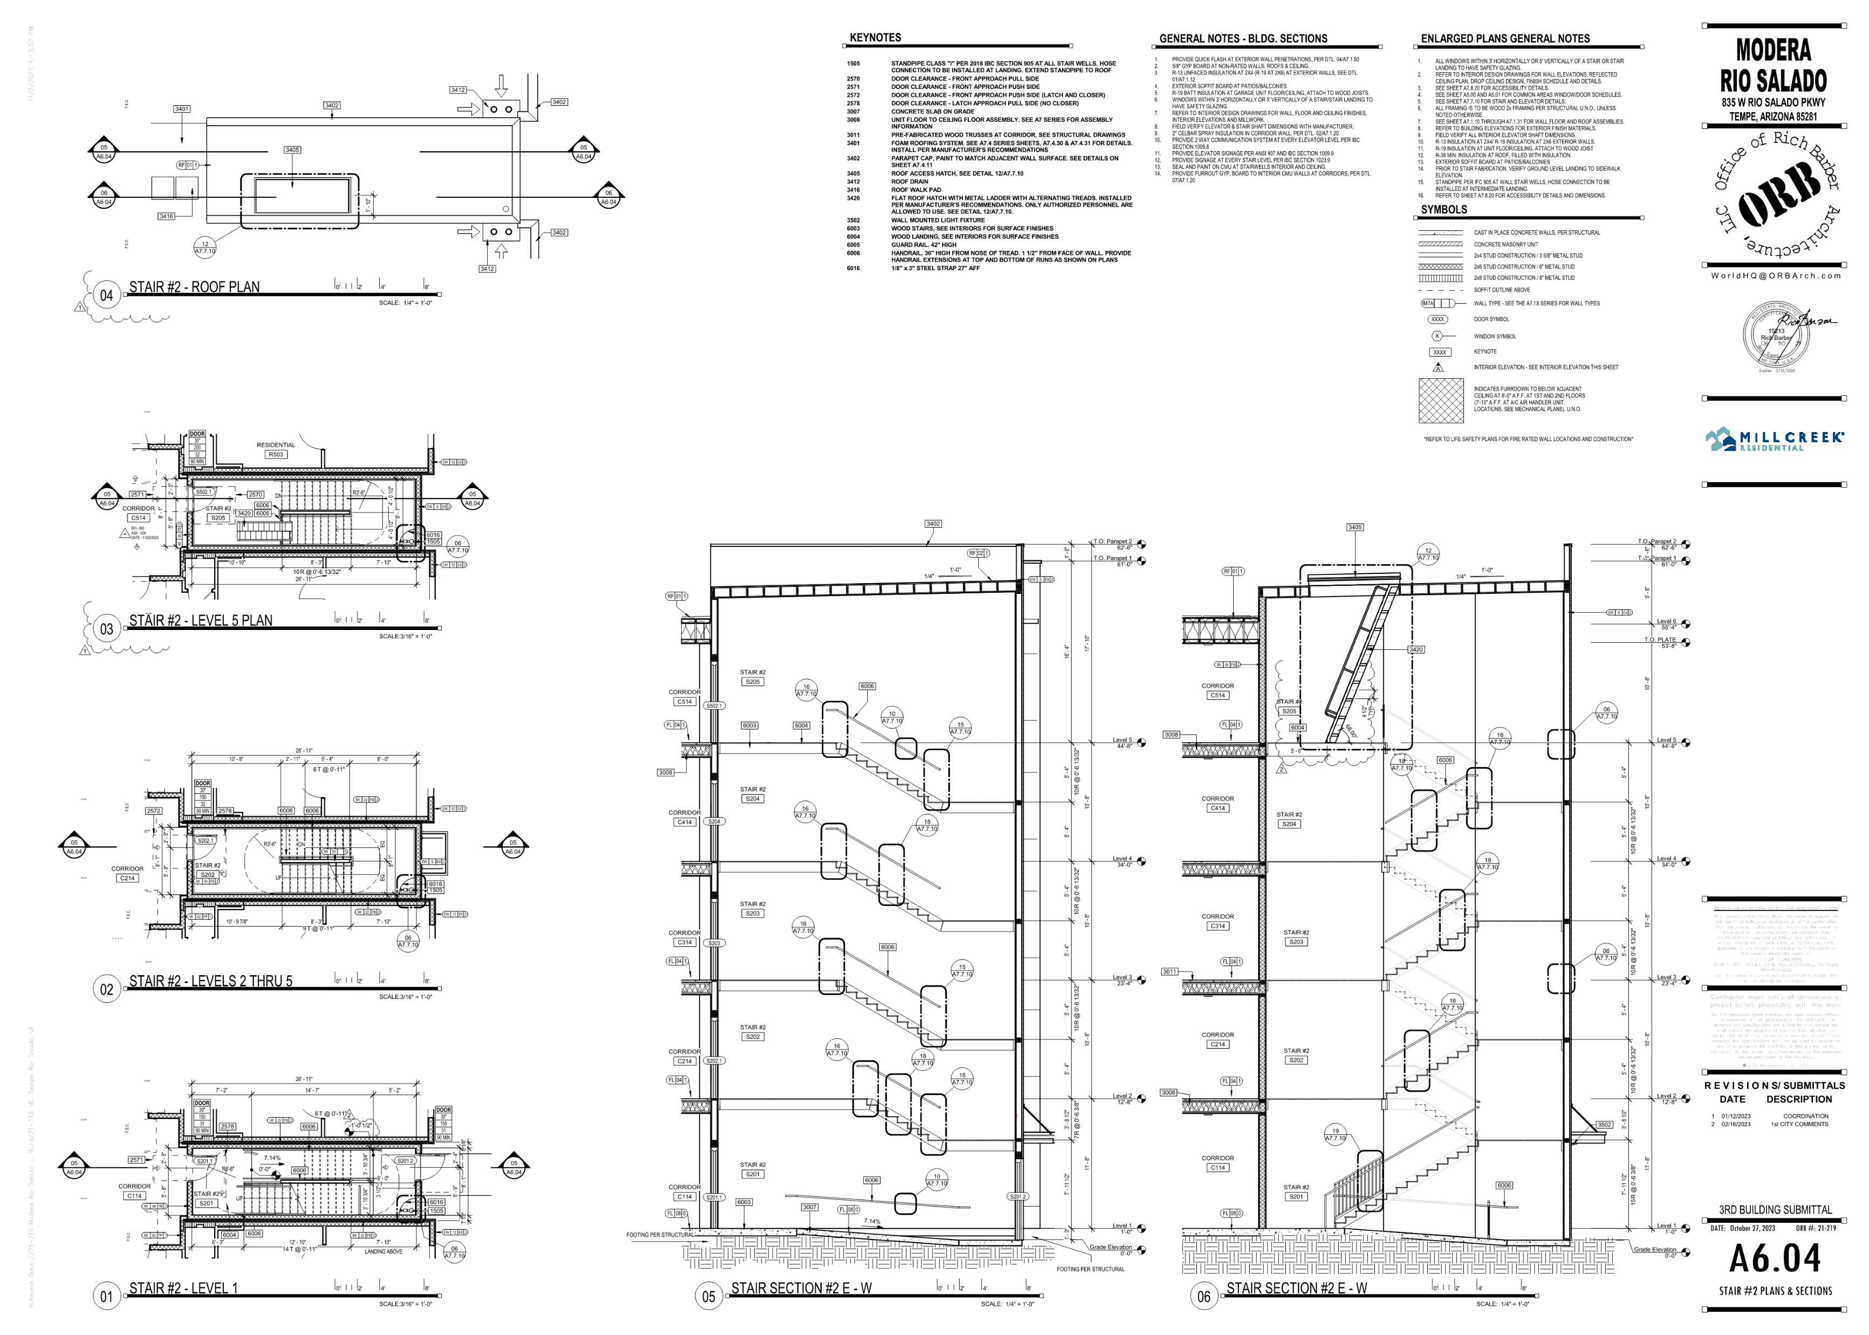
REVISED ELEMENT
SHEET
30X42
DUMMY TAG FOR RFI / ASK

Slide 12
REVISED ELEMENT
SHEET
30X42
DUMMY TAG FOR RFI / ASK

Slide 13
REVISED ELEMENT
SHEET
30X42
DUMMY TAG FOR RFI / ASK

Slide 14
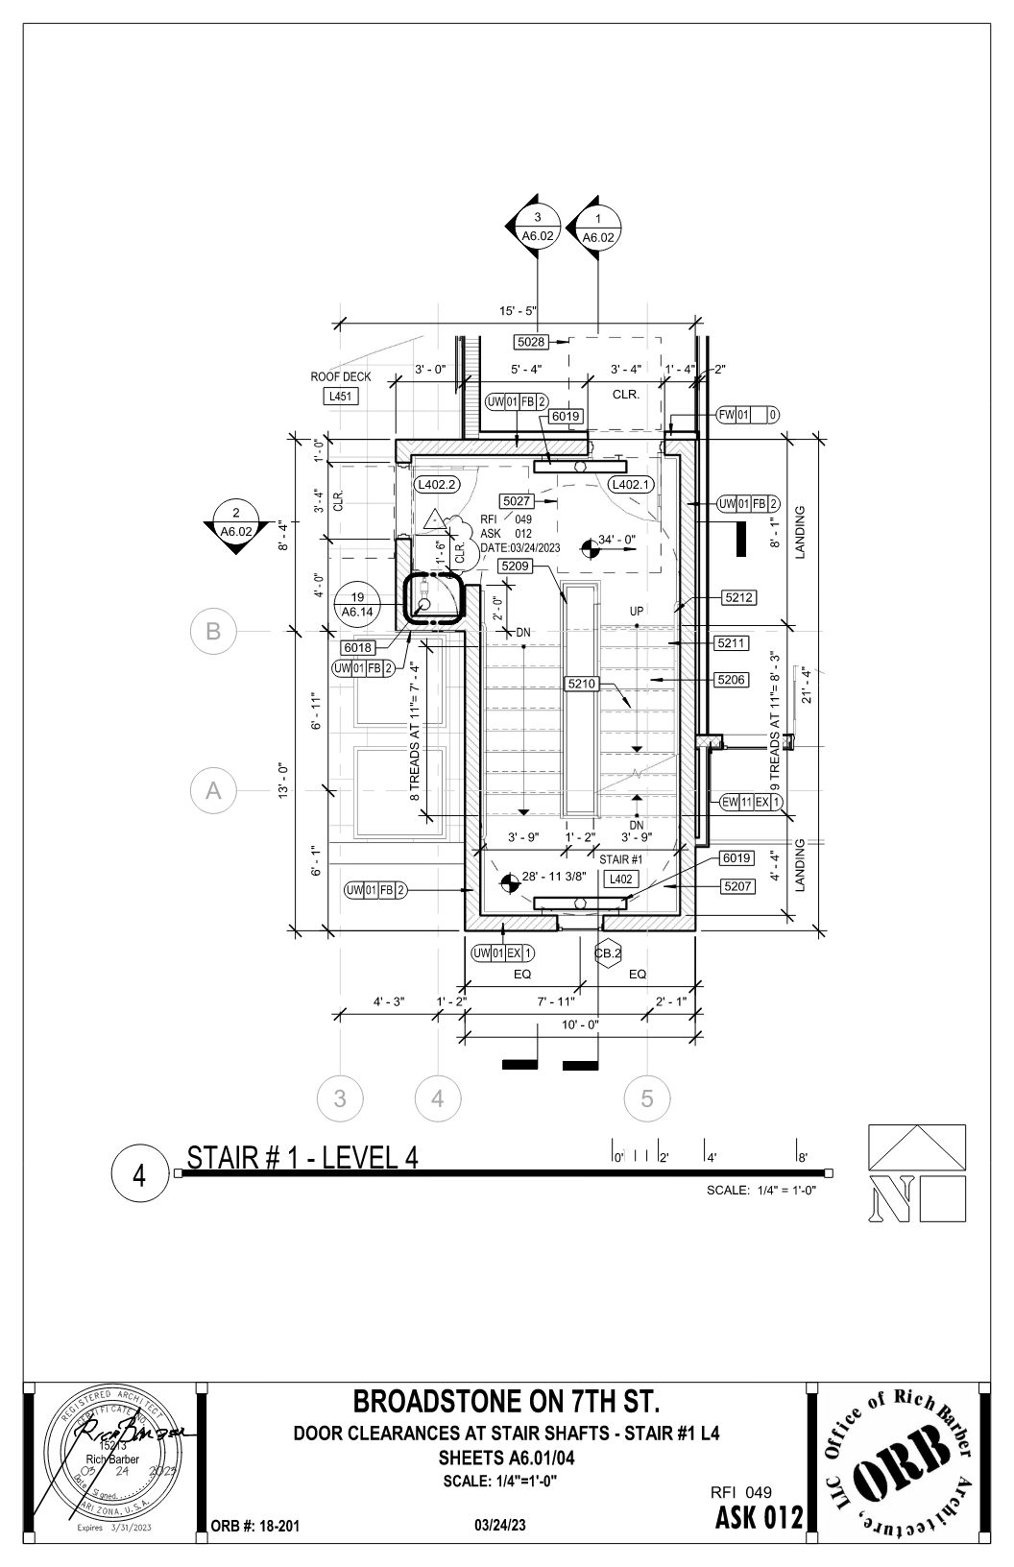
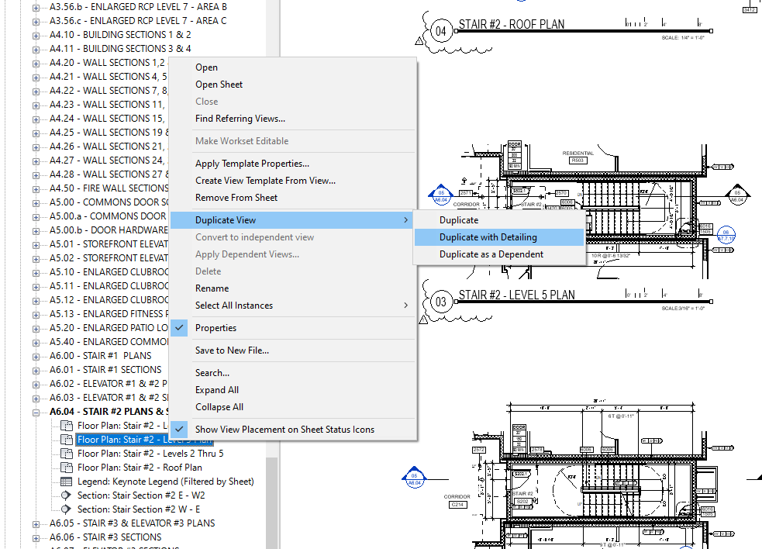
REVISED ELEMENT
DUPLICATE VIEW WITH DETAILING
SHEET
SKETCH
30X42
DUMMY TAG FOR RFI / ASK
8.5x11 / 11x17
DESCRIPTION
RFI #
ASK #
AFFECTED SHEET

Slide 15
REVISED ELEMENT
DUPLICATE VIEW WITH DETAILING
SHEET
SKETCH
30X42
DUMMY TAG FOR RFI / ASK
8.5x11 / 11x17
DESCRIPTION
RFI #
ASK #
AFFECTED SHEET

Slide 16
REVISED ELEMENT
SKETCH
8.5x11 / 11x17
DESCRIPTION
RFI #
ASK #
AFFECTED SHEET

Slide 17
REVISED ELEMENT
SKETCH
8.5x11 / 11x17
DESCRIPTION
RFI #
ASK #
AFFECTED SHEET

Slide 18
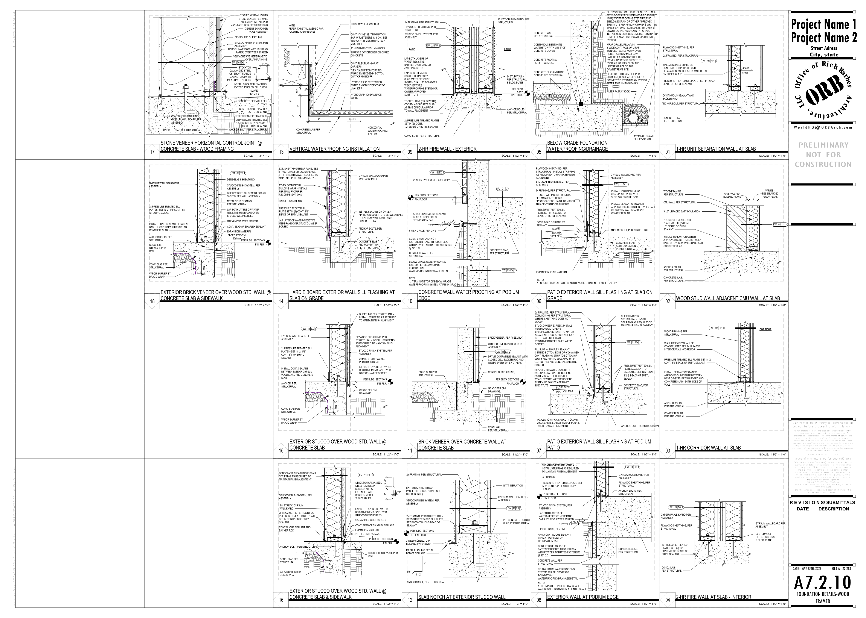

Slide 19
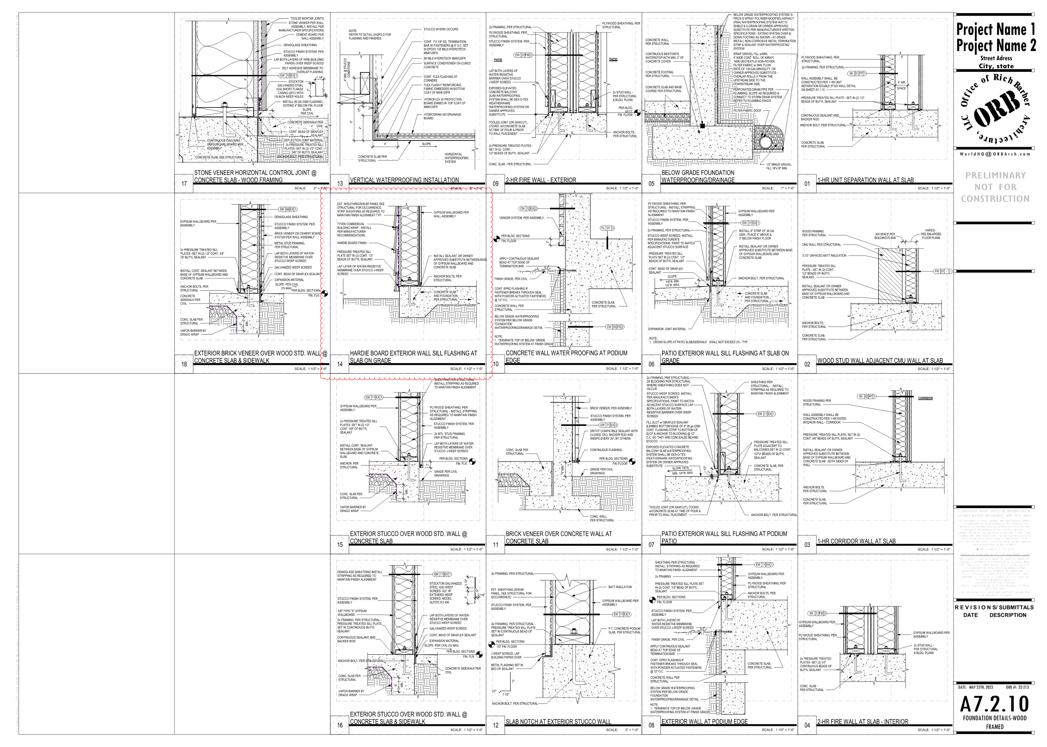

Slide 20
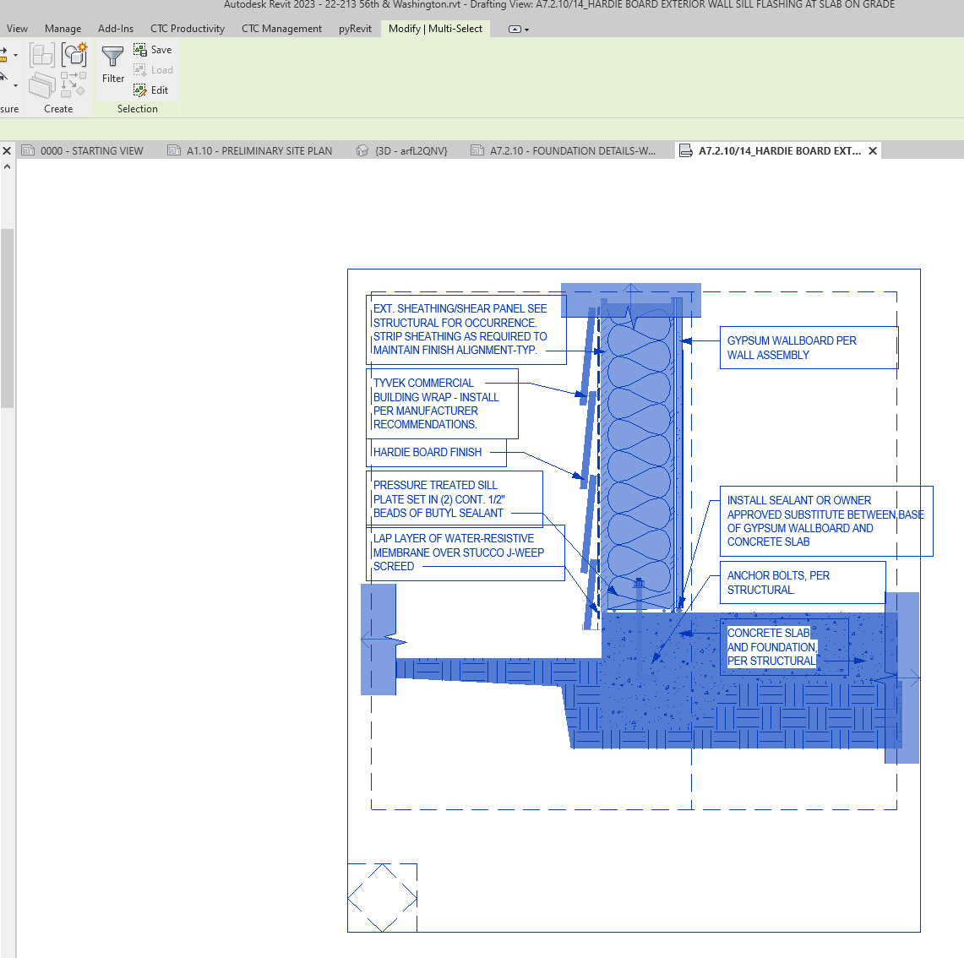
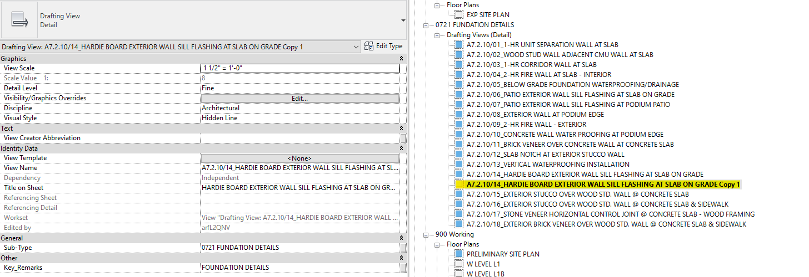
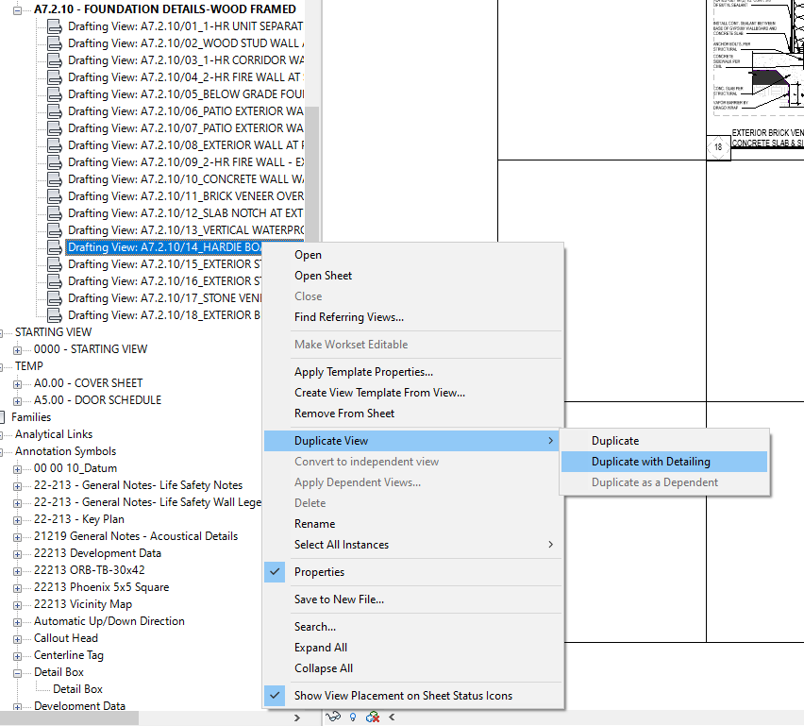

Slide 22
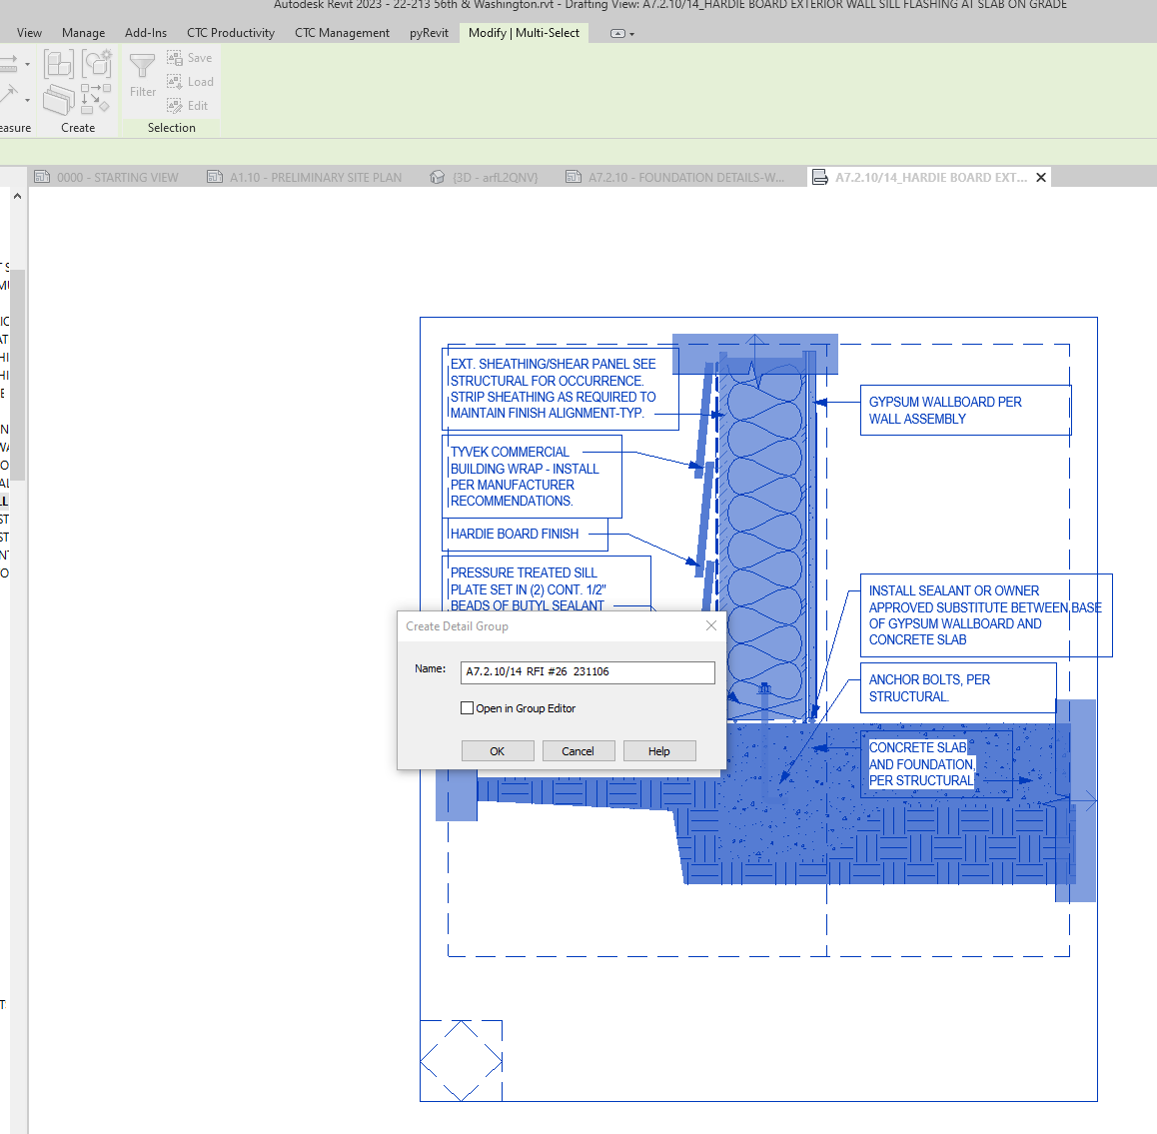
CREATE A GROUP OF THE FULL DETAIL
NAME THE GROUP:
DETAIL NAME / RFI # / DATE
DUPLICATE THE VIEW (WITH DETAILING)
RE-NAME NEW VIEW WITH RFI / SK # & DATE
PLACE ON SK SHEET
ISSUE TO CA
RE-NAME TO INCLUDE RFI / SK INFORMATION AT THE END

Slide 23
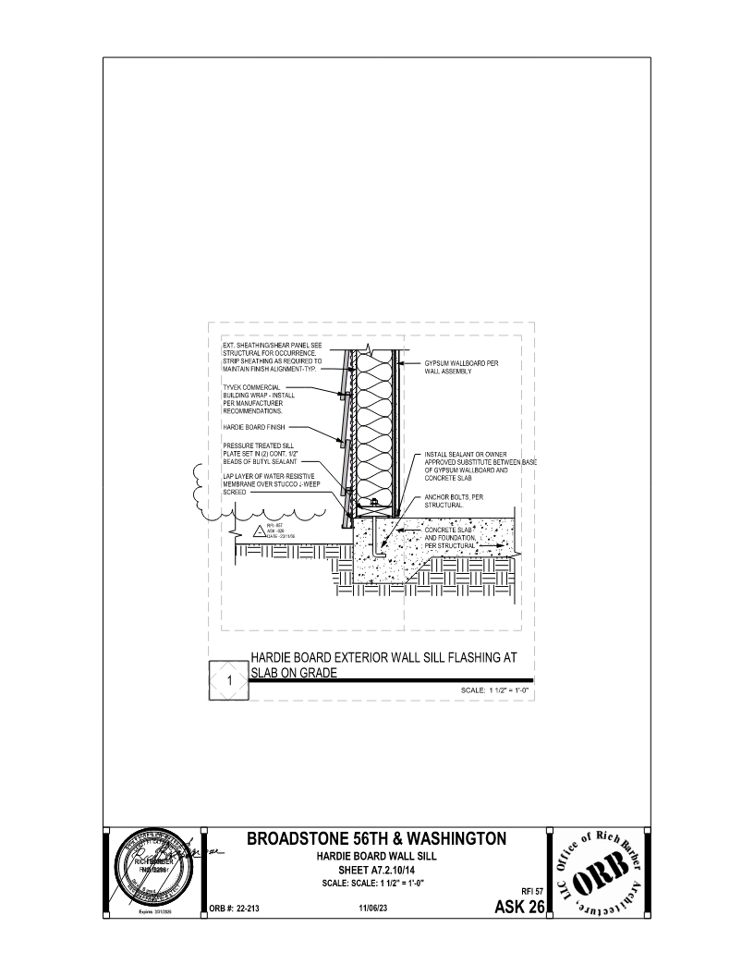
INLCUDE THE RFI / SK INFORMATION IN THE DRAWING OF THE DETAIL
THIS INFORMATION NEEDS TO SHOW UP IN BOTH PLACES.
CREATE A GROUP OF THE FULL DETAIL
NAME THE GROUP:
DETAIL NAME / RFI # / DATE
DUPLICATE THE VIEW (WITH DETAILING)
RE-NAME NEW VIEW WITH RFI / SK # & DATE
PLACE ON SK SHEET
ISSUE TO CA
RE-NAME TO RFI TO SORT BY CATEGORY

Slide 24
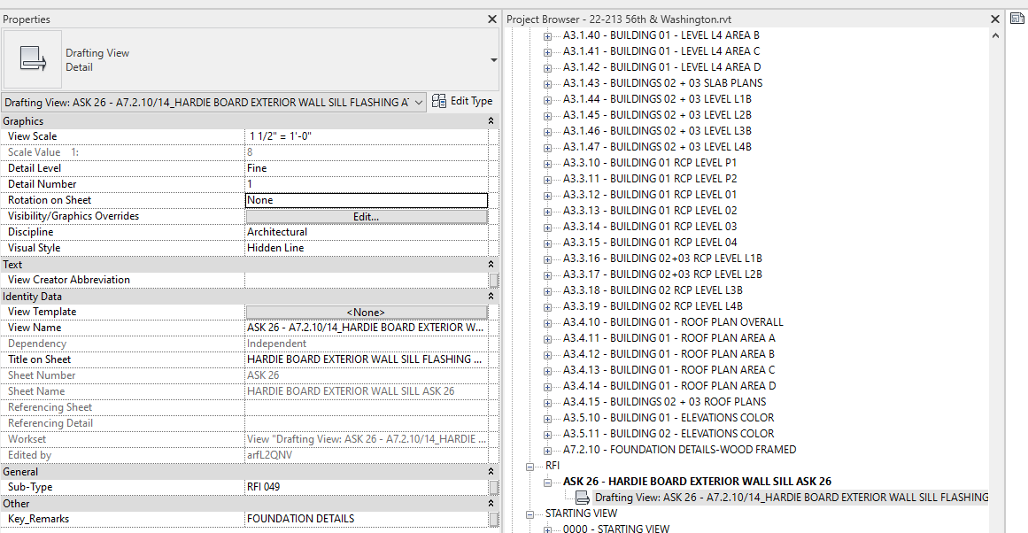
INLCUDE THE RFI / SK INFORMATION IN THE DRAWING OF THE DETAIL
THIS INFORMATION NEEDS TO SHOW UP IN BOTH PLACES.
NAMING CONSISTENCY IS KEY
PROVIDE ALL REQUIRED INFORMATION ON THE TITLE BLOCK
NEW VIEW NAME WITH ASK # AT THE BEGINNING
SUB-TYPE RENAMED TO RFI #
CREATE A GROUP OF THE FULL DETAIL
NAME THE GROUP:
DETAIL NAME / RFI # / DATE
DUPLICATE THE VIEW (WITH DETAILING)
RE-NAME NEW VIEW WITH RFI / SK # & DATE
PLACE ON SK SHEET
ISSUE TO CA
RE-NAME TO RFI TO SORT BY CATEGORY

Slide 25
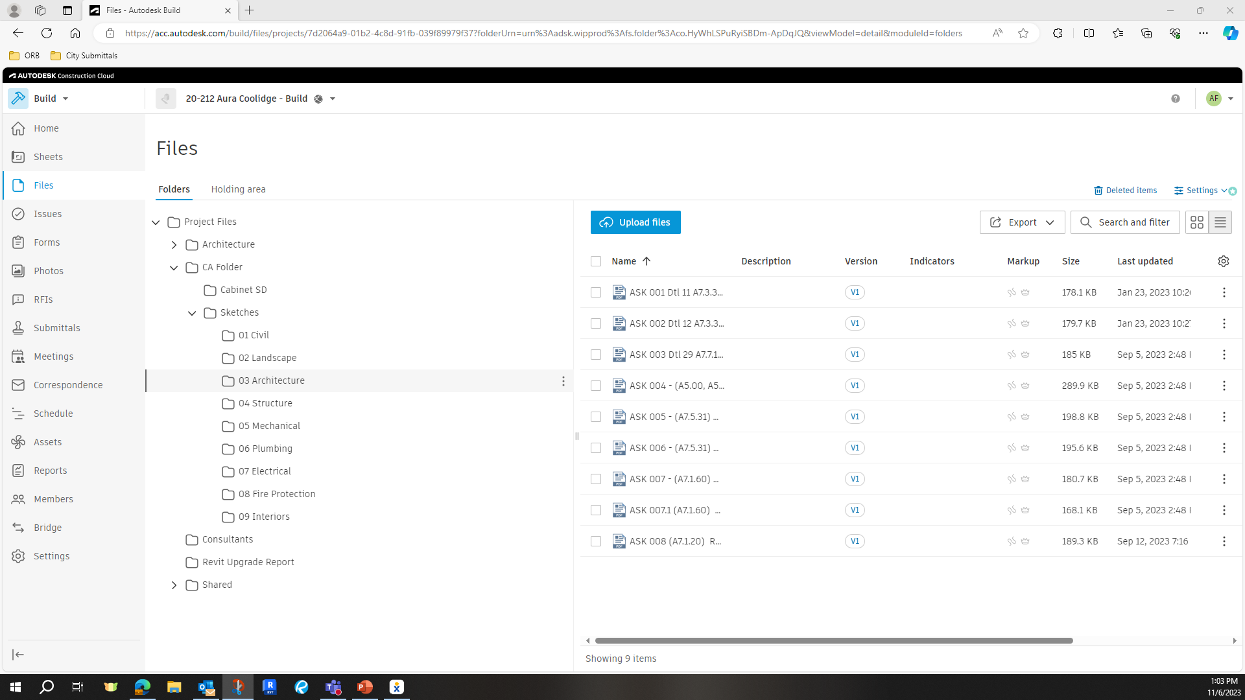
CONSTRUCTION ADMINISTRATION
SK VS Δ (DELTA)
LOGGED
UPLOADED
ARCHIVED
AS DETERMINED BY THE PROJECT MANAGER
SCOPE OF ELEMENTS CHANGED
SCOPE OF SHEETS AFFECTED
SK OR Δ,
FULL SIZE SHEET & SK SHEET ARE PROVIDED TO CA DEPARTMENT (CA COORDINATOR)
USE GROUPS TO MAINTAIN INFORMATION CONSISTENT ON BOTH SIDES

Slide 26
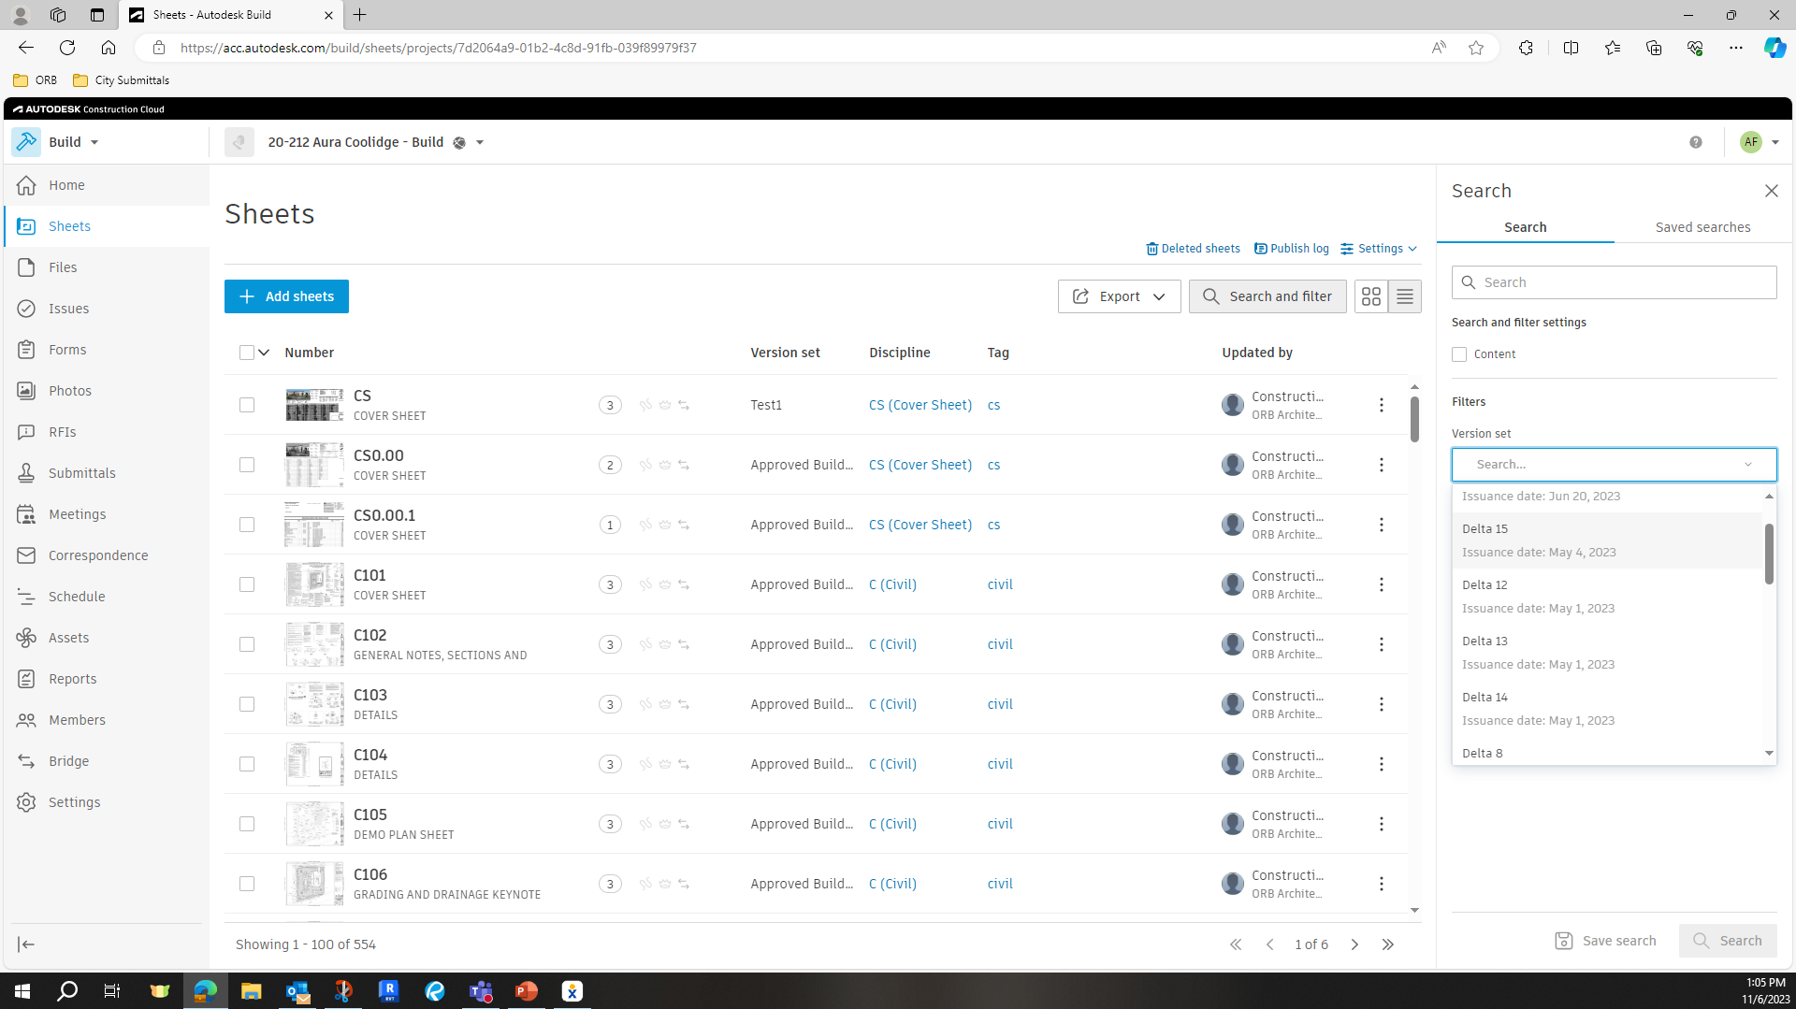
SK VS Δ (DELTA)
LOGGED
UPLOADED
ARCHIVED
AS DETERMINED BY THE PROJECT MANAGER
SCOPE OF ELEMENTS CHANGED
SCOPE OF SHEETS AFFECTED
SK OR Δ,
FULL SIZE SHEET & SK SHEET ARE PROVIDED TO CA DEPARTMENT (CA COORDINATOR)
CONSTRUCTION ADMINISTRATION

Slide 27
CONSTRUCTION ADMINISTRATION
PUT IT ALL TOGETHER

